Slide 1

RecBooks
Find your next read
Made By -
Mihir Dholakia - 1811074
Jash Shah - 1811082
Jay Shah - 1811112
Naman Shah - 1811113
Group number: C11
Project Mentor: Prof. Kavita Kelkar

Slide 2
Problem Definition
Reading is an activity that is enjoyed by a lot of people. Reading can increase knowledge, help you relax and reduce stress, make you a better writer, enhance your vocabulary and improve your focus. However, readers often run into the problem of not finding the right book that fits their personal taste and style of reading which can sometimes waste a lot of time and effort. To solve this problem, we will implement a recommendation system and make use of data from various users to recommend new books based on the past reading habits of the reader.

Slide 3
Scope
Users will be asked to login/register first
Advanced book searching filters using
Title
Author
Category
Publisher
ISBN Barcode Scanner
Recommendations based on: —> content and item based
Books bookmarked by the user
Books similar to the genre or title of the book page they visit
Profile Creation
Links for purchase displayed

Slide 4
Software/Hardware Requirements
Hardware(for development purpose):
Processor - dual core or higher
GPU - 8GB Memory or higher
Hardware(for user): Smartphone with decent camera
Software(for development purpose):
● Framework - Flutter
● Tools - Firebase, Android Studio Code(IDE), Visual Studio Code(IDE), GitHub, Google Collaboratory
Software(for user):
● Mobile versions: Android Jelly Bean, v16, 4.1. x or newer
● Permissions needed: Camera, Media and Storage permissions
● Other requirements: Reliable internet connection

Slide 5
Literature Survey
https://www.semanticscholar.org/paper/Title-Extraction-from-Book-Cover-Images-Using-of-Do-Kim/1948e0361ce8b8f82b49effb0b655fd991076a59?p2df
Title: Title Extraction from Book Cover Images Using Histogram of Oriented Gradients and Color Information
http://ieeexplore.ieee.org.library.somaiya.edu/stamp/stamp.jsp?tp=&arnumber=9396414
Title: Development of Book Recommendation Service for Implementation on Android
http://ieeexplore.ieee.org.library.somaiya.edu/stamp/stamp.jsp?tp=&arnumber=8614724
Title: Research on Personalized Book Recommendation Model for New Readers

Slide 6
Literature Survey
http://ieeexplore.ieee.org.library.somaiya.edu/stamp/stamp.jsp?tp=&arnumber=6779375
Title: Book Recommendation System Based on Combine Features of Content Based Filtering, Collaborative Filtering and Association Rule Mining
https://web.stanford.edu/class/ee368/Project_Autumn_1617/Reports/report_yang_shen.pdf
Title: Book Cover Recognition

Slide 7
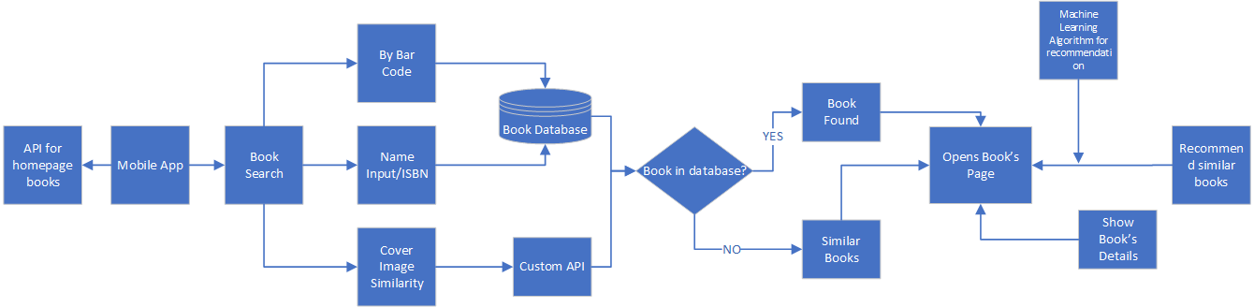
Proposed System design diagram

Slide 8
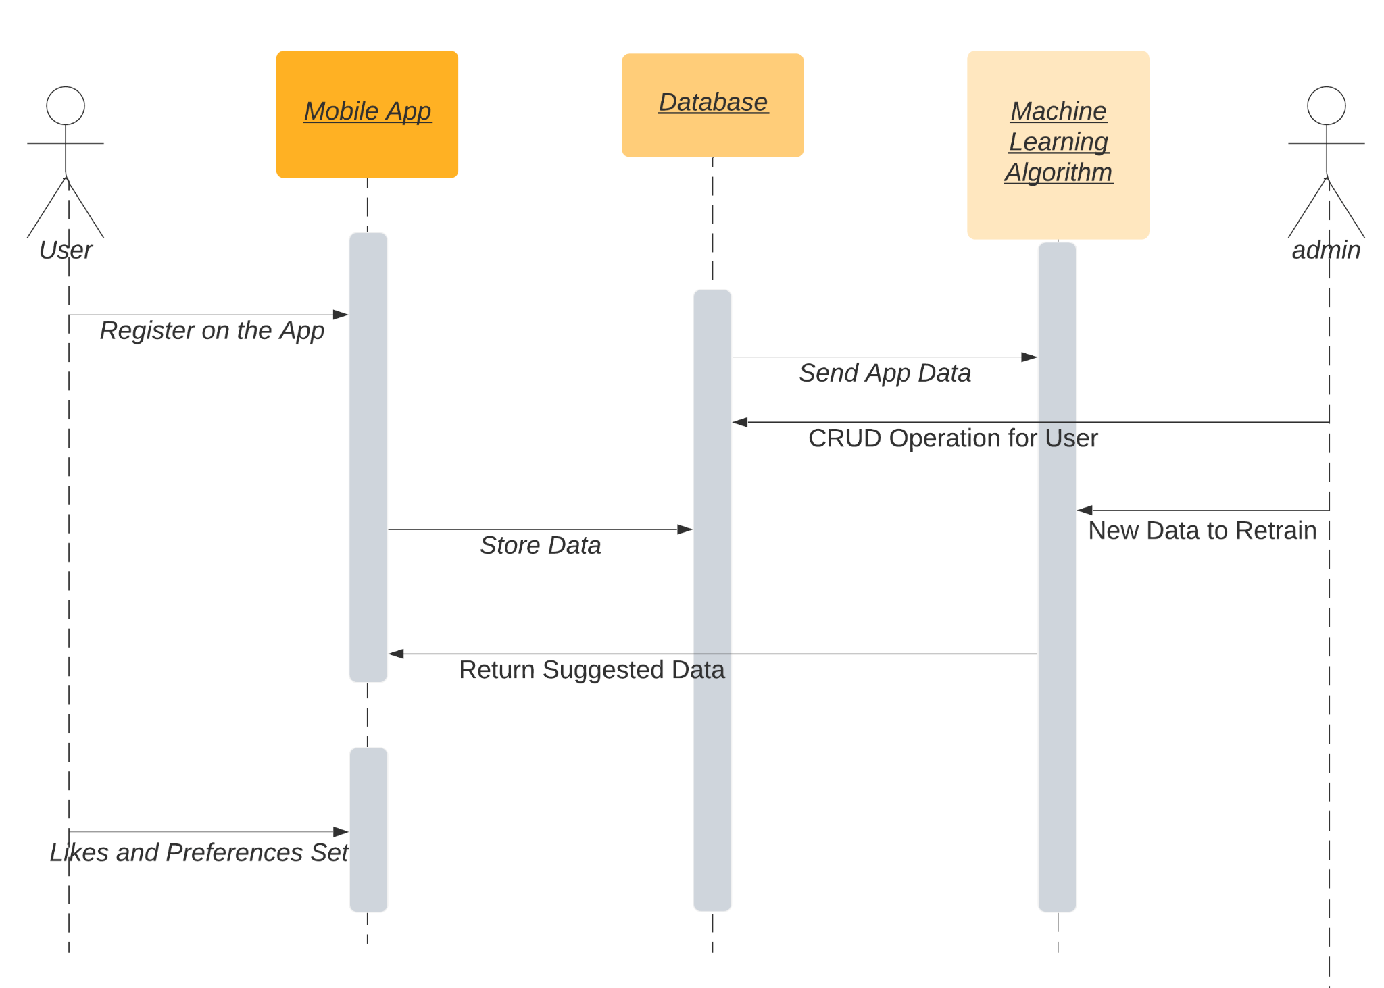
Sequence diagram

Slide 9
Data Collection
Attribute | Description
User_id | Unique id given to each user
ISBN | Unique code through which every book is recognized globally
Rating | Rating given by a user to book
Book Title | Title of the book
Book Author | Author of the book
Year of publication | Year in which book was published
Publisher | Publication company of the book
Image_small | Image link for small size image
Image_medium | Image link for medium size image
Image_large | Image link for large size image
Summary | A brief introduction to the book
Language | Language in which the book is written
Category | Genre of the book
Dataset: Book-Crossing: User review ratings - A collection of book ratings. Contains 278,858 users providing 1,149,780 ratings (explicit / implicit) about 271,379 books.
Data source: Kaggle
Additionally, we have scraped some data.

Slide 10
Data Scraping
The dataset had a column named ISBN 13 but some values were missing, hence we had to scrape ISBN 13 for the missing books in the dataset from Google Books
For converting ISBN 13 to 10, we encountered some problems, hence isbn 10 was scraped completely. We needed ISBN 10 because old books might have ISBN 10 so to complete the dataset we scraped ISBN 10 values from Google Books
Notes:
New slide

Slide 11
Data Preprocessing
Elimination of attributes that are not required for analysis
Removal or replacement of null and negative values
Removal of duplicate tuples to avoid overfitting
Anomalies and outliers were detected and removed if they were present

Slide 12
Recommendation system details
There are 2 types of recommendation systems that we have implemented:
Content based collaborative filtering(based on title, summary, author, publication)
Item-Based Collaborative filtering(Based on title only)

Slide 13
Item based collaborative filtering
Collaborative filtering systems are used because they are based on the opinion of the other users.
This takes into account the title of the books only.
Item based collaborative recommendation algorithm looks into the set of items the target user has rated and computes how much similar they are to the target item i and then selects k- most similar items { i1,i2…..,ik} to the set of items the target user has rated, the recommendation is then computed by taking the weighted average of the target user’s rating on these similar items.
To compute the similarity between the two items, each item is considered as a vector in m dimensional user-space. The similarity between two items is measured by computing the cosine of the angle between the two vectors.

Slide 14
Content based collaborative filtering
Content based filtering: Based on the content(based on title, summary, author, publication etc.) of the buyers past book buying history.
Book buying history gives the content of the overview of the books, in which the buyer is generally interested in the large amount of books.
Based on the similarity in content of the books, new books are recommended.
Content recommendation system uses content based filtering for doing the separation.

Slide 15
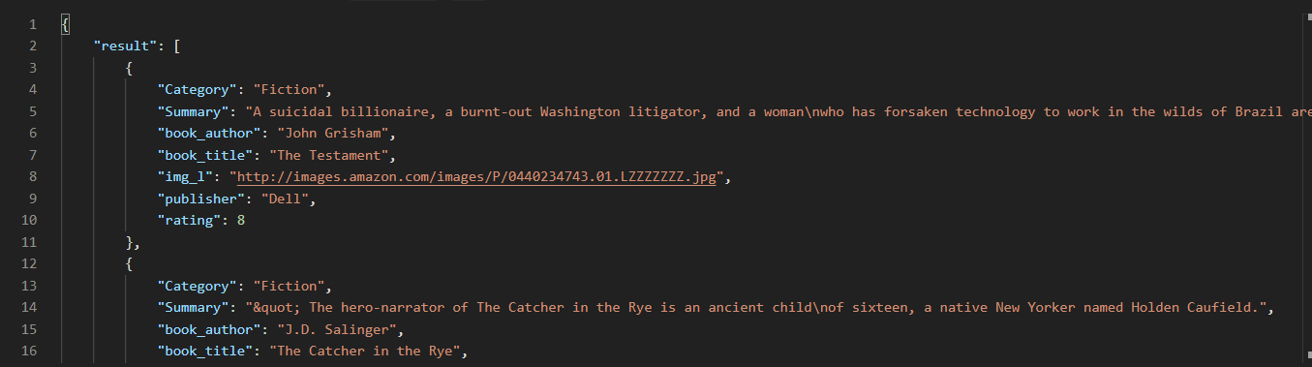
Output of the API

Slide 16
API
As the application needs to fetch the data from somewhere, we have uploaded the flask application and all the necessary files on the Python Anywhere platform which would help in hosting the Flask API which can be used by the Flutter Application.
The API will return the result in a simple JSON Format which can be used to display the necessary details on the application.
The URL is:
Item Based Recommendation: https://namanshah0008.pythonanywhere.com/recommend1/?title
Content Based Recommendation: https://namanshah0008.pythonanywhere.com/recommend2/?title
In Both URLs, we need to add the title of the book which is used as a parameter to show up to 5 books which the user might like.

Slide 17
Mobile Application

Slide 18
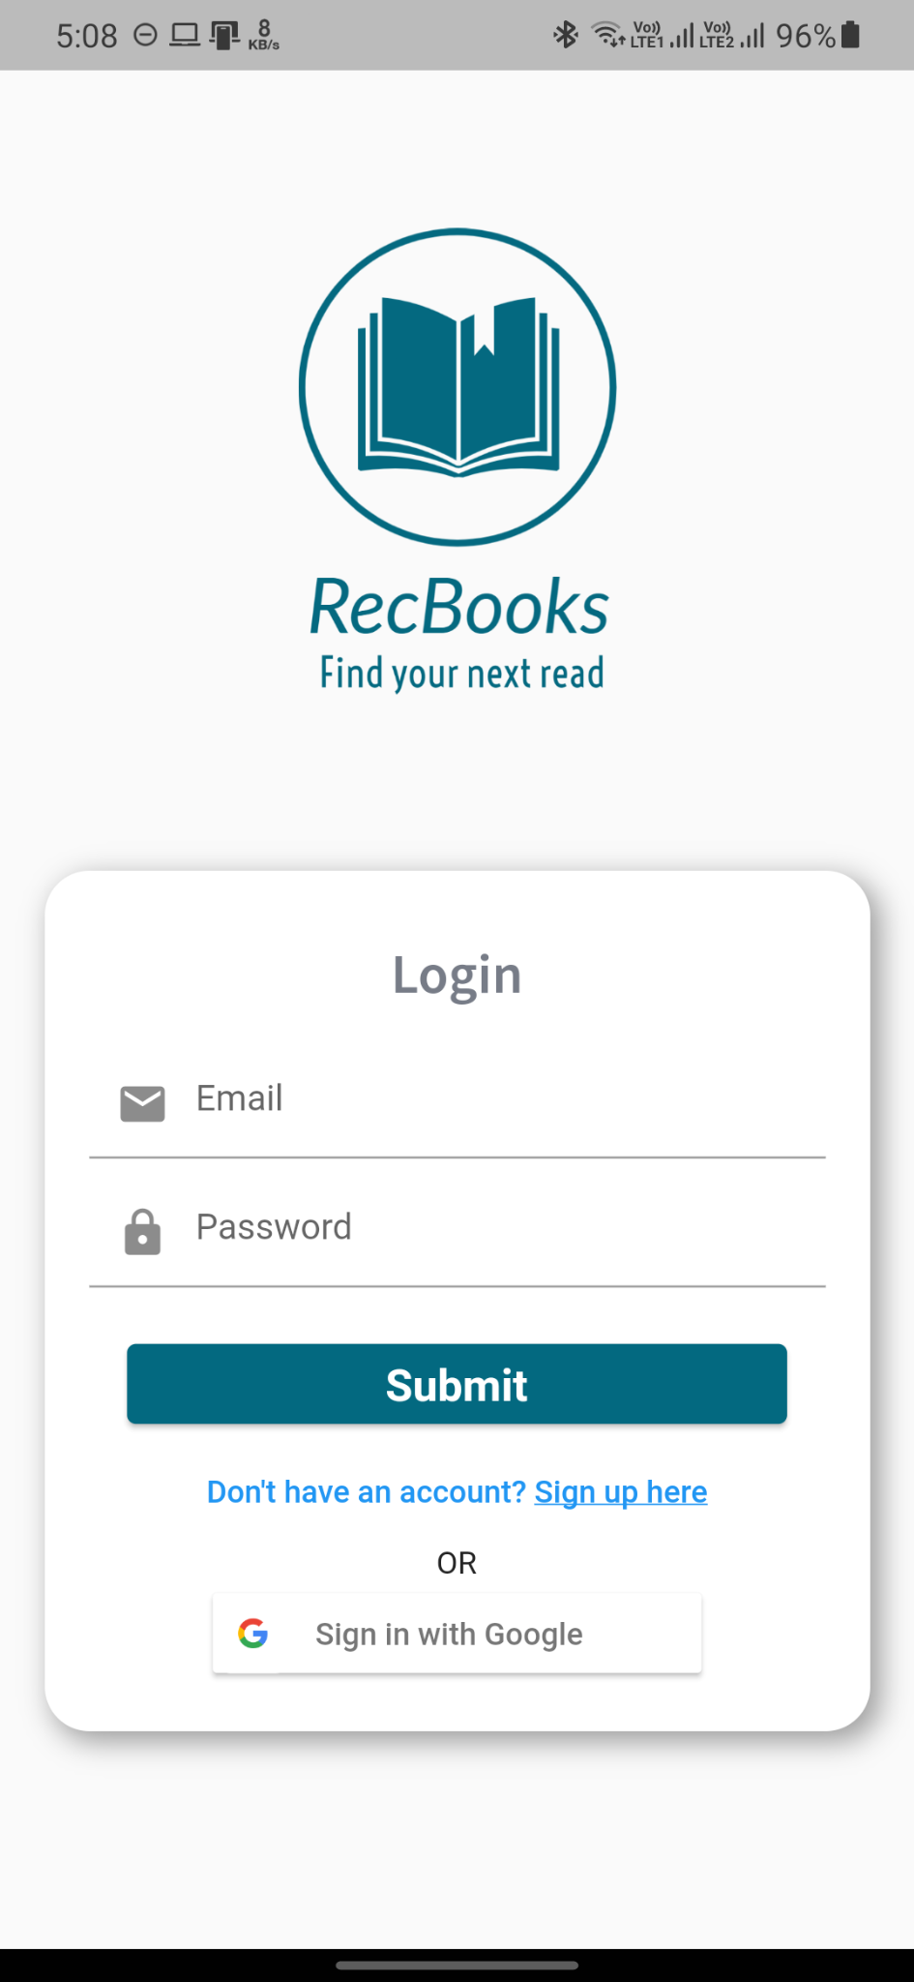
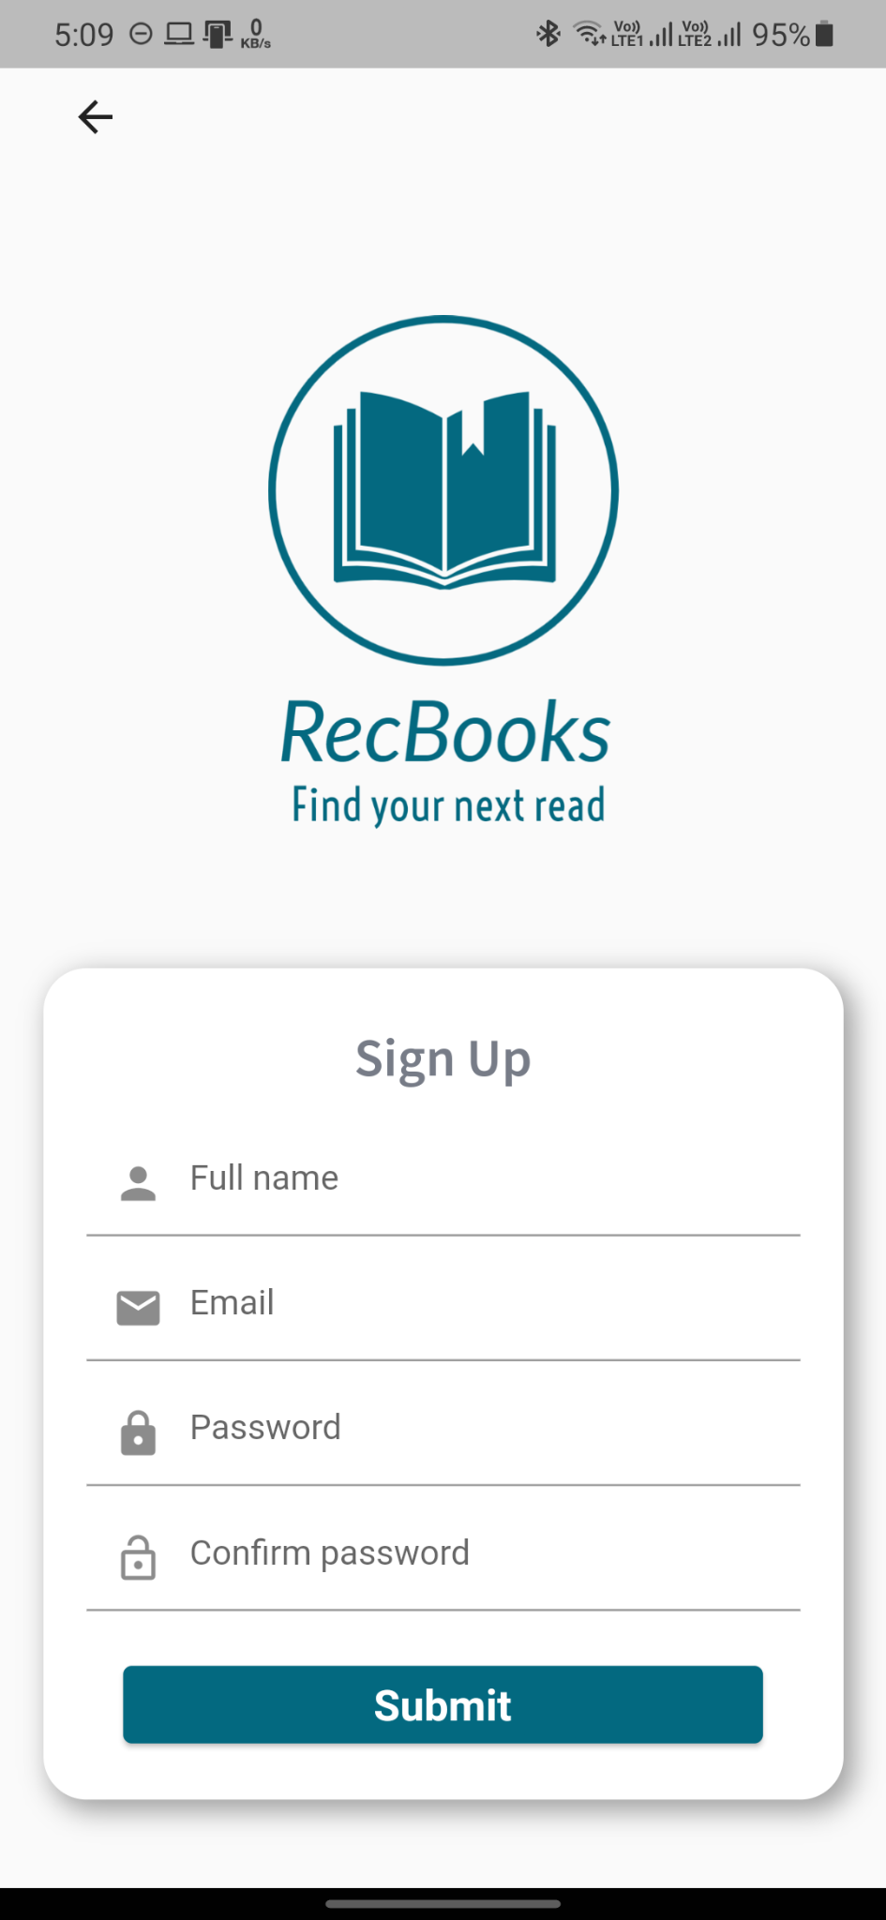
Screenshots of the Application

Slide 19
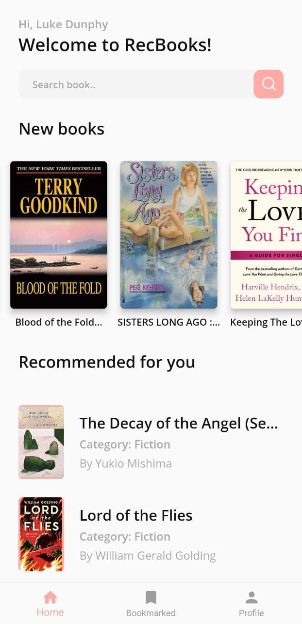


Slide 20
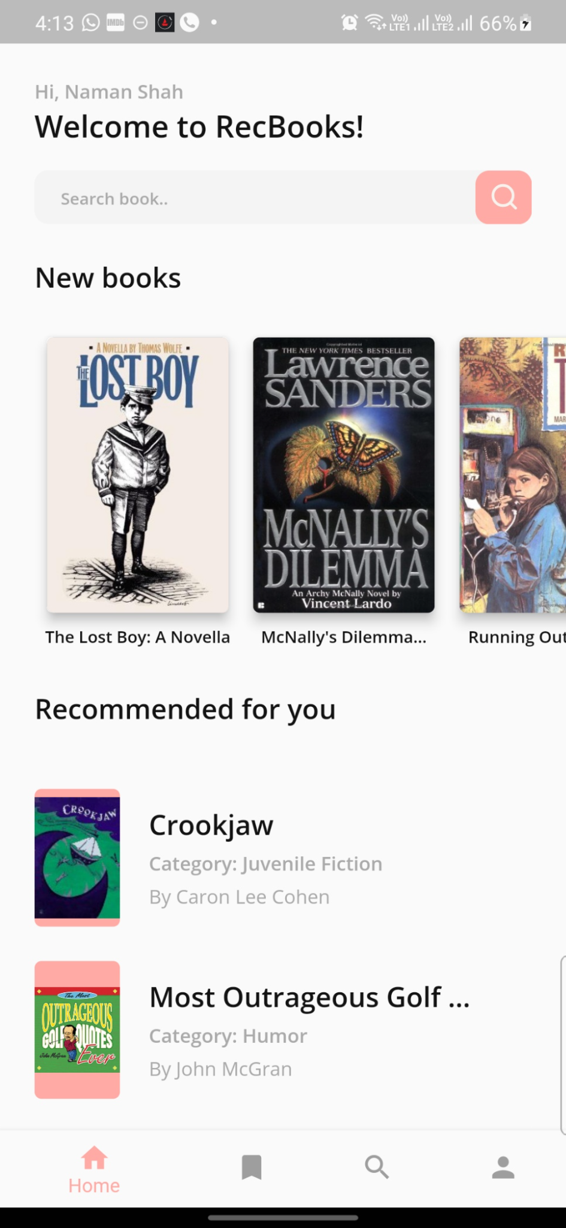
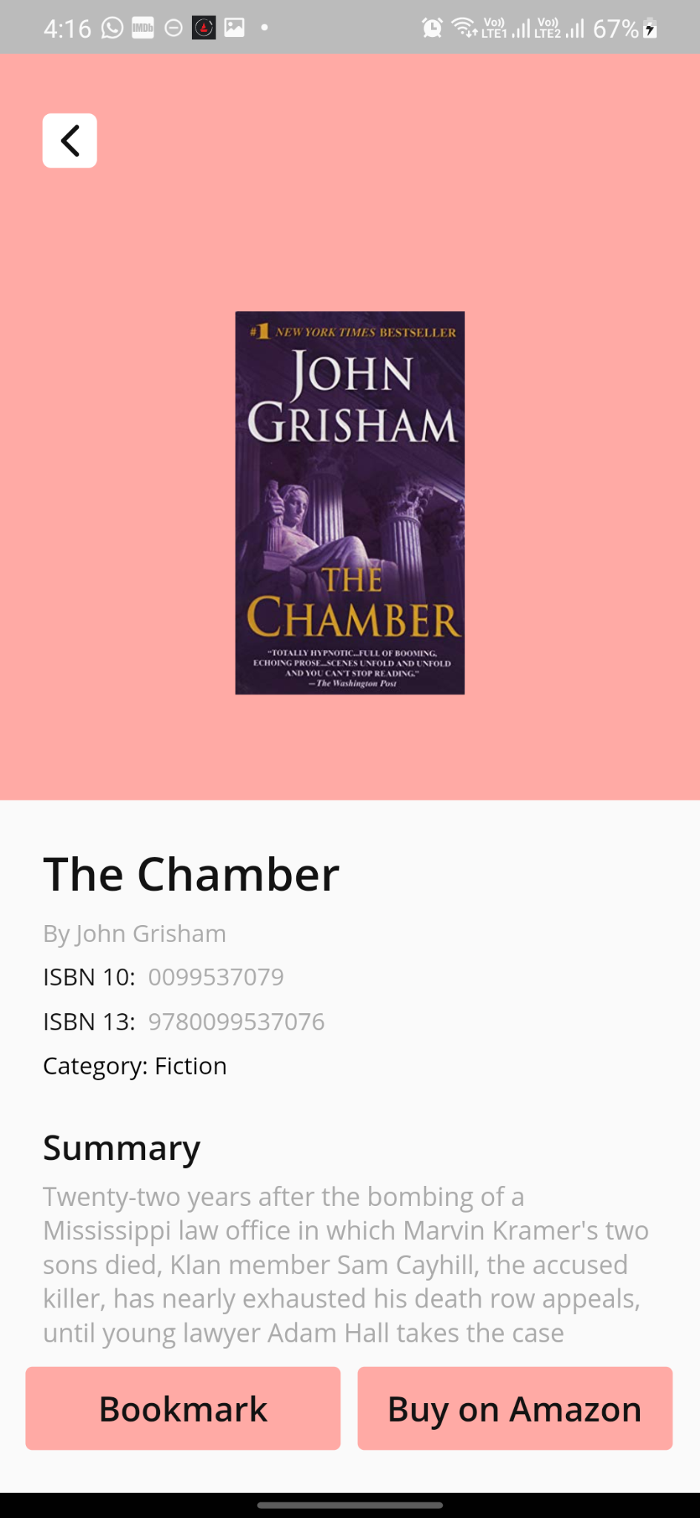
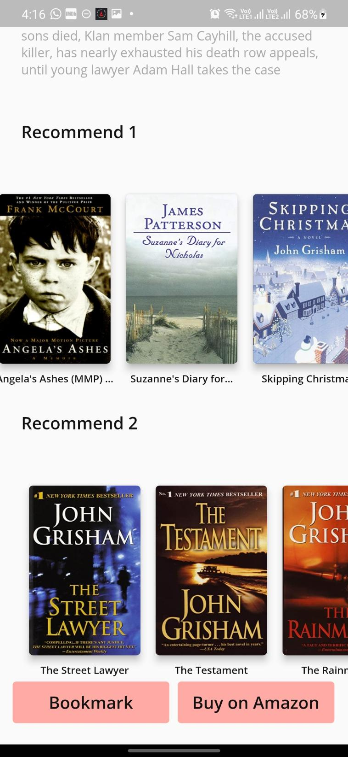
Notes:
New Screenshots of UI

Slide 21
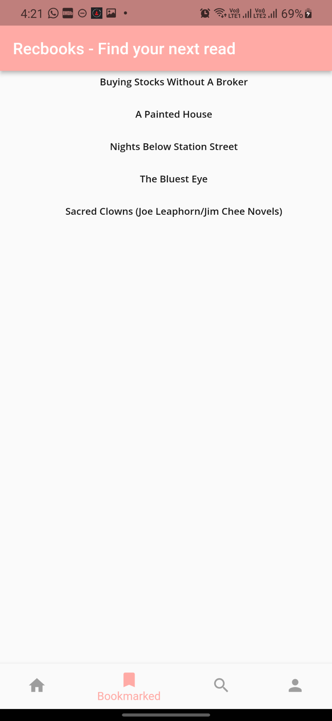
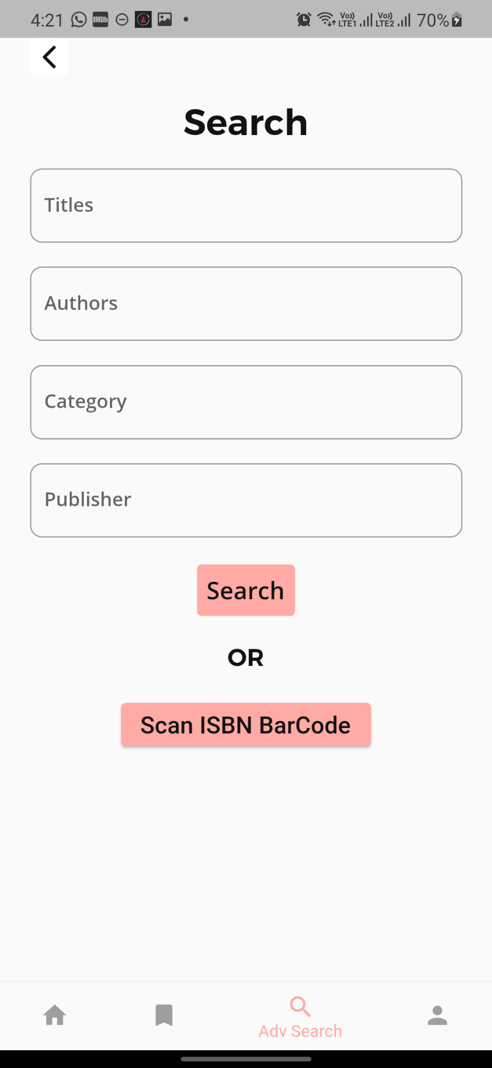
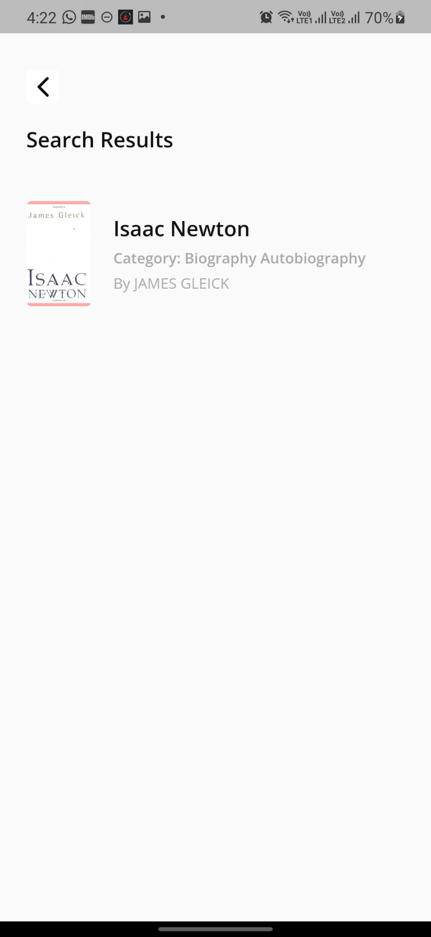
Notes:
New Screenshots of UI

Slide 22
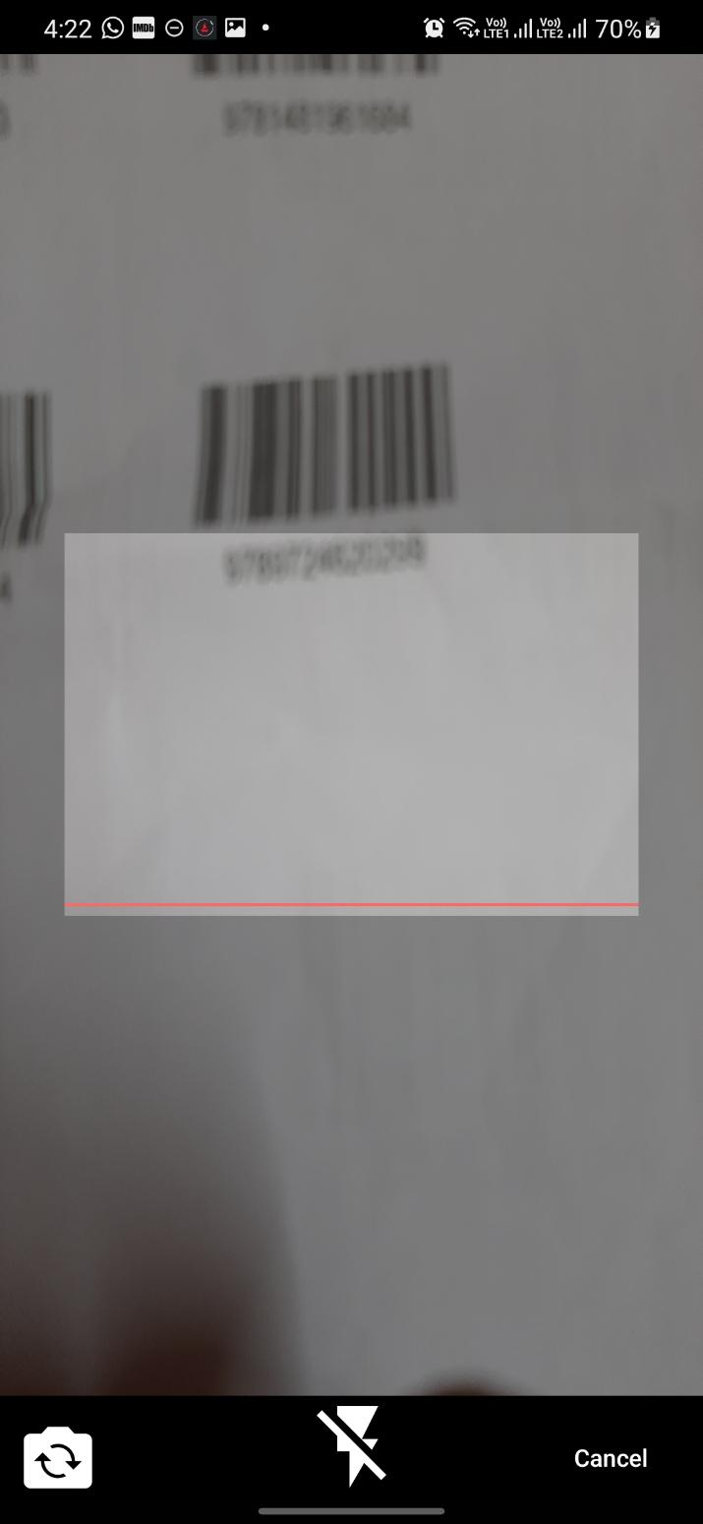
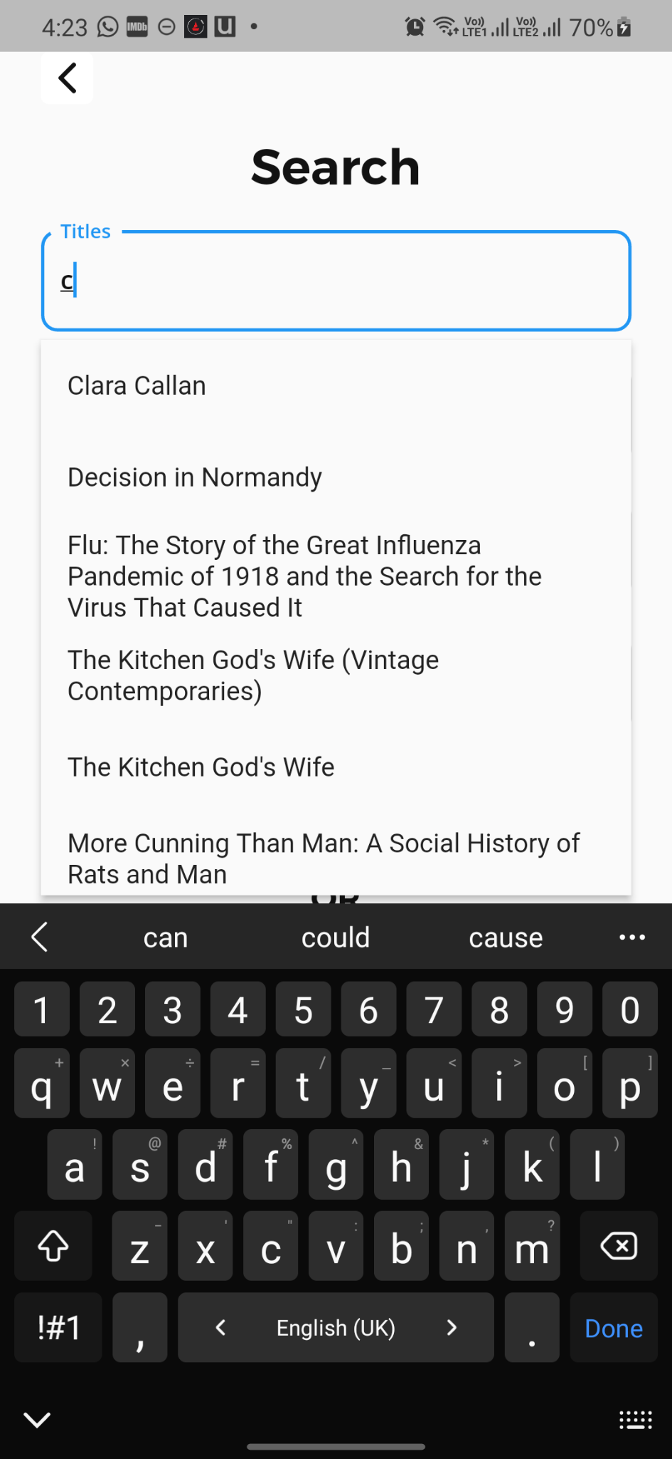
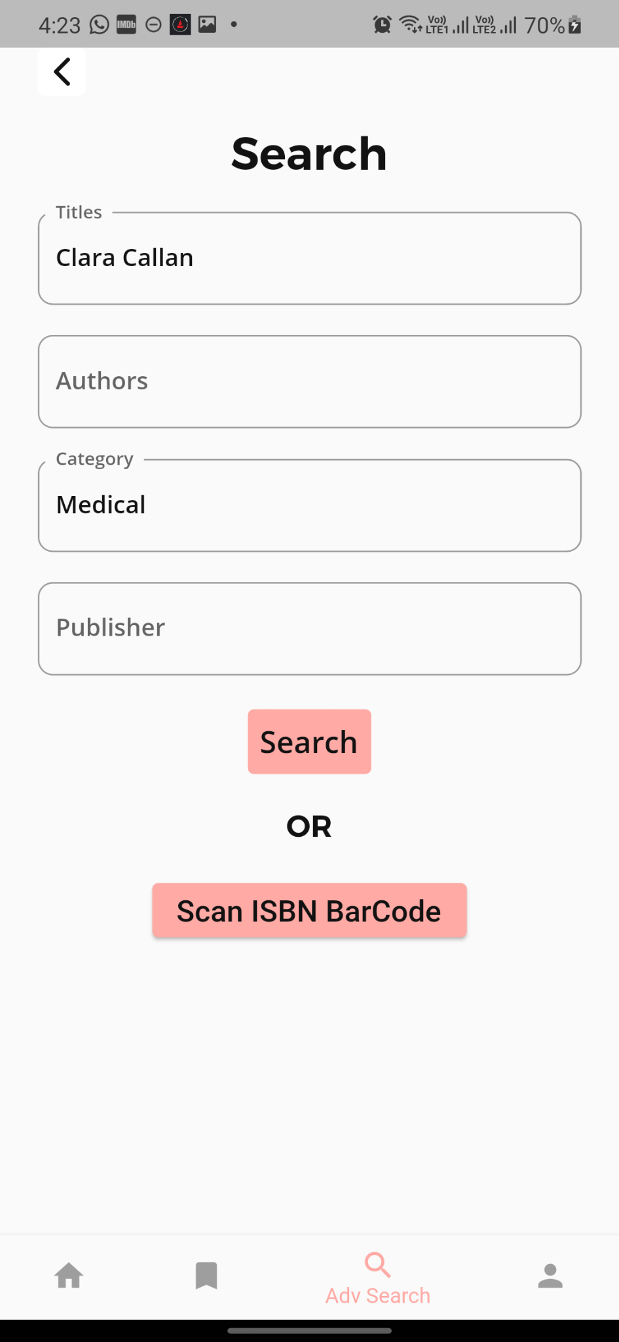
Notes:
New UI Screenshots

Slide 23
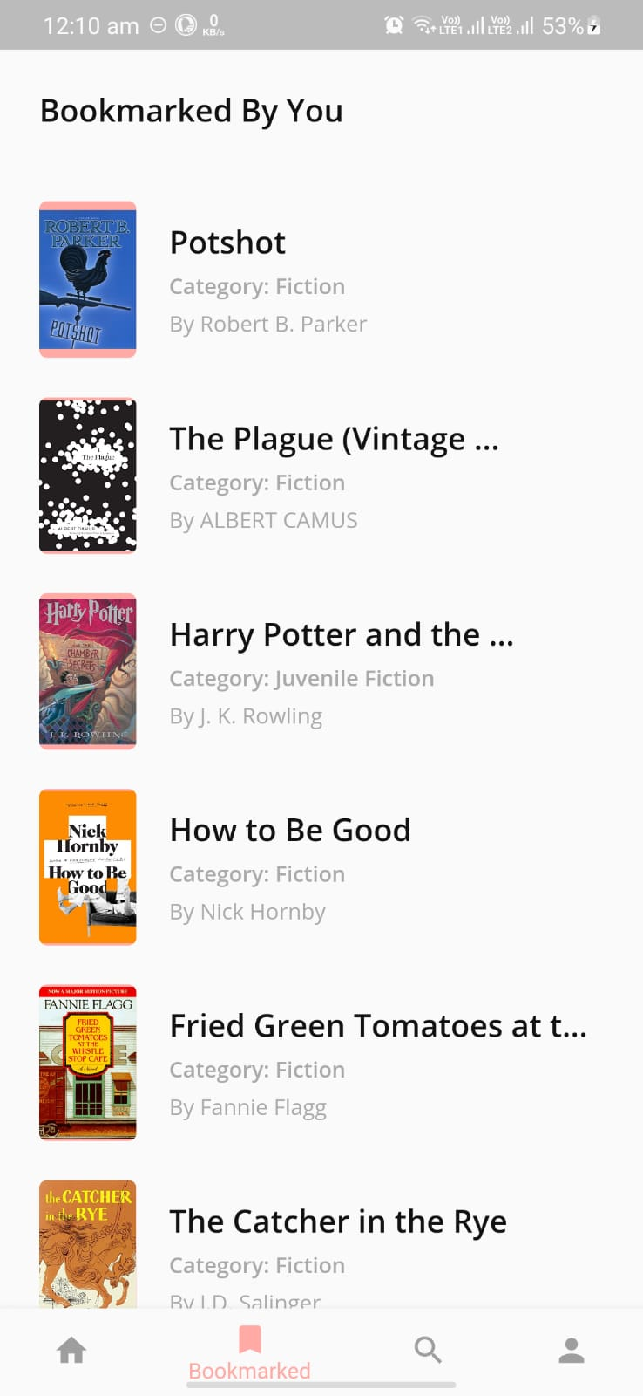

Slide 24
Live Demo

Slide 25
Future Work
Working on the technical paper
Cold start recommendation for new users and New books section backend changes
Releasing this app on the play store and app store
Getting application feedback from more users so we can get a conclusive result of our recommendation system

Slide 26


